Slide 1
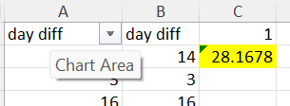
CASE STUDY 1
It is observed that an average of 28 days is taken between the requested date and completion date

Slide 2
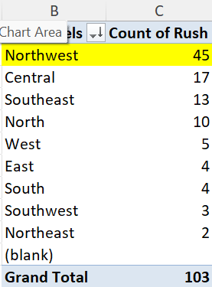
CASE STUDY 2
It is observed Northwest district has the highest count of Rush Jobs with a count of 45

Slide 3
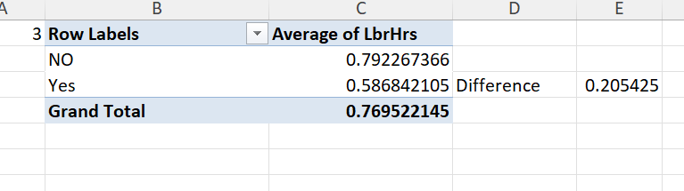
CASE STUDY 3
It is observed that the average labour hours of RUSH Jobs is lesser than No RUSH Jobs and the difference if found.

Slide 4
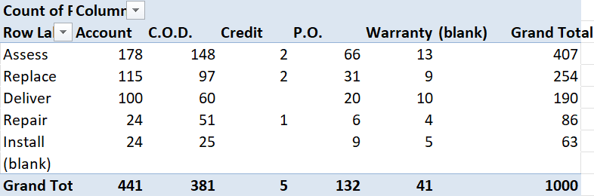
CASE STUDY 4
The distribution of payment types across different services is shown, and could be inferred that, the ASSESS service has contributed in almost all types of payment with highest payment count among other services.

Slide 5
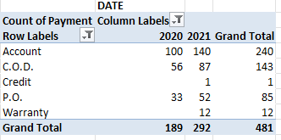
CASE STUDY 5
From 2020, the count of payment types has been increased in every payment types.

Slide 6
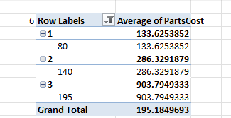
CASE STUDY 6
As the number average parts of cost increases, the number of technicians req also increased.

Slide 7
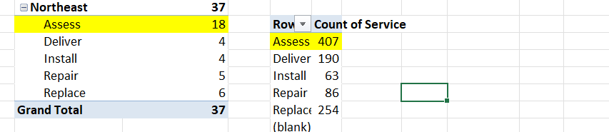
CASE STUDY 7
The Most Common Part of Service required is Asses, with a count of 407

Slide 8
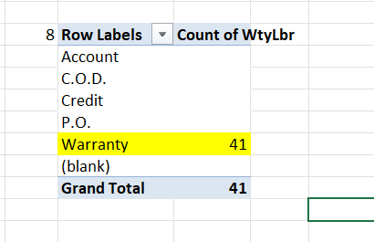
CASE STUDY 8

Slide 9
